Slide 1
Cainan Black Senior Project
Java Calculator Application

Slide 2
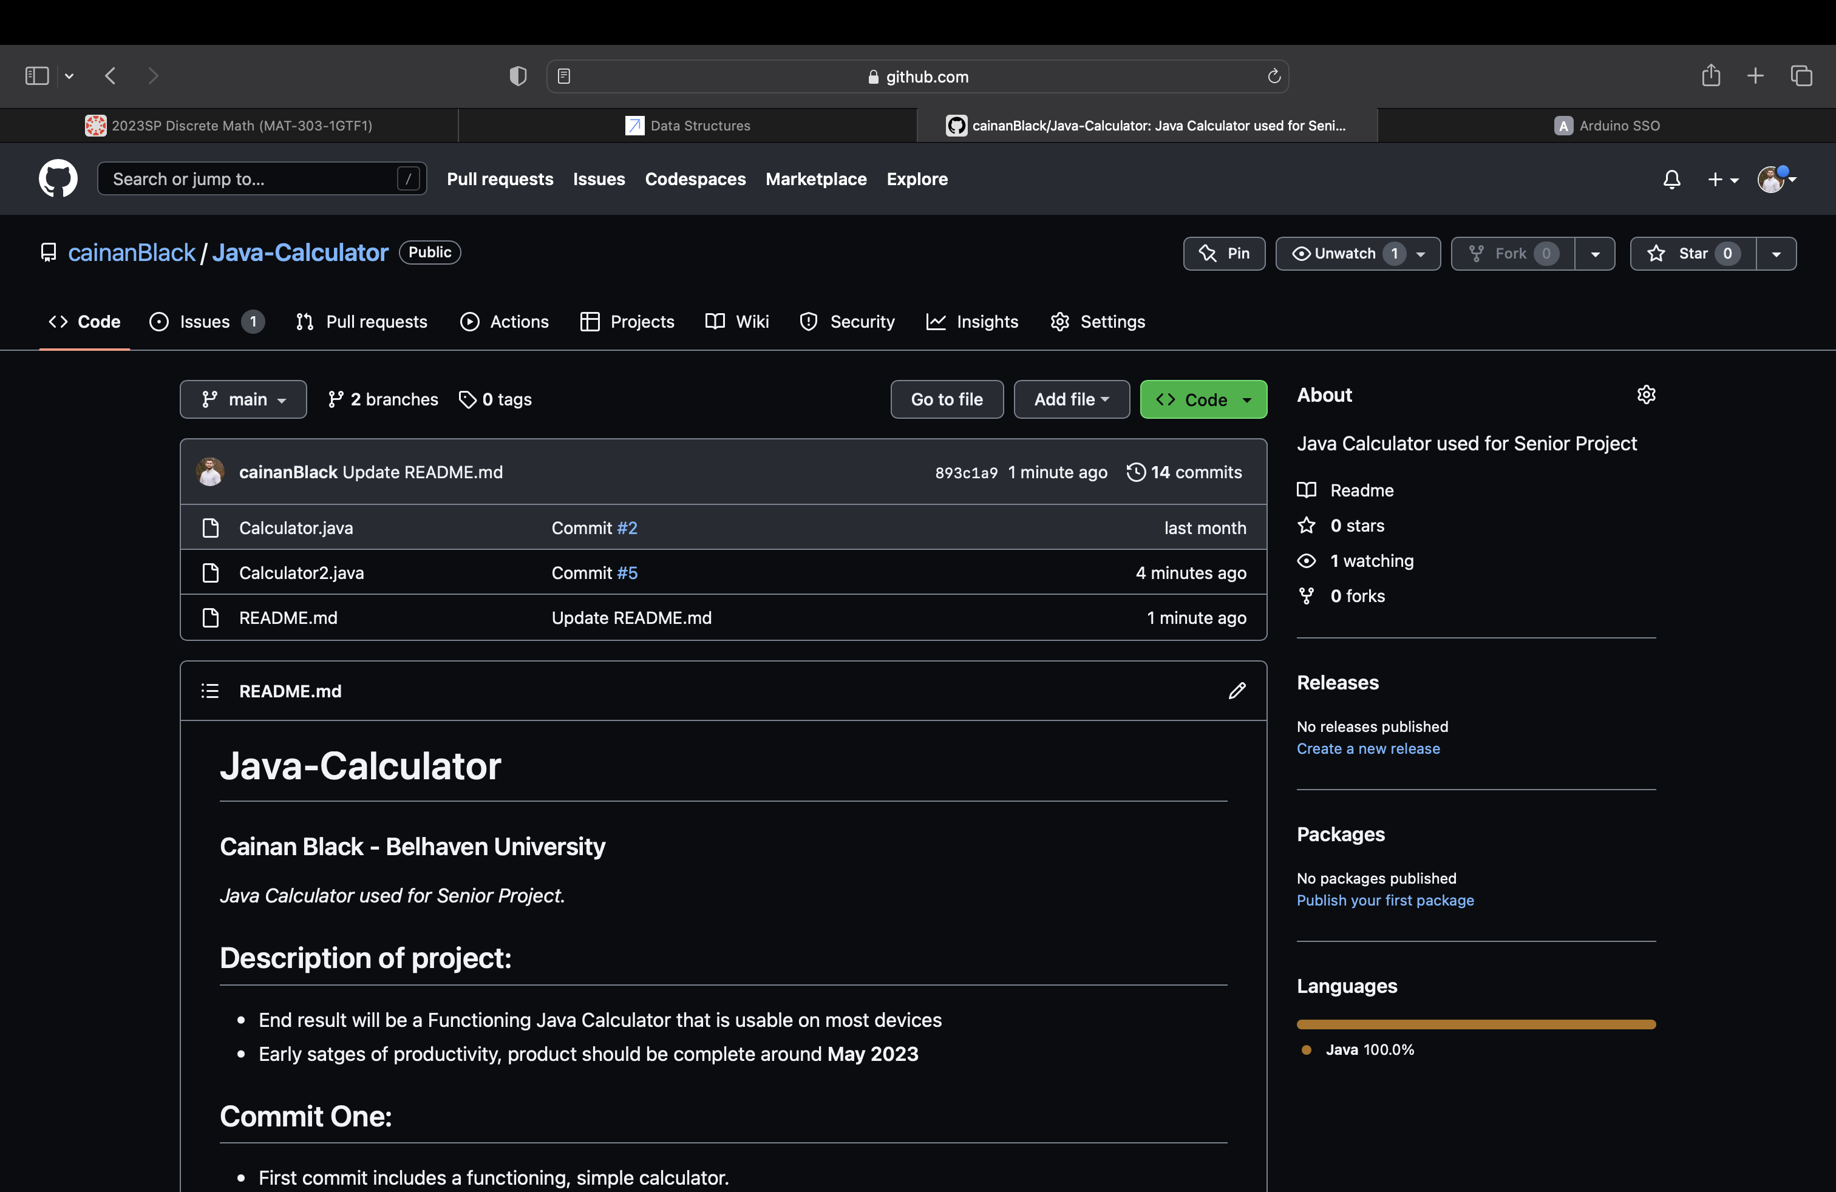
Git Repo
Added all the code and slides to the GitHub repo.
Commit Five is up.

Slide 3
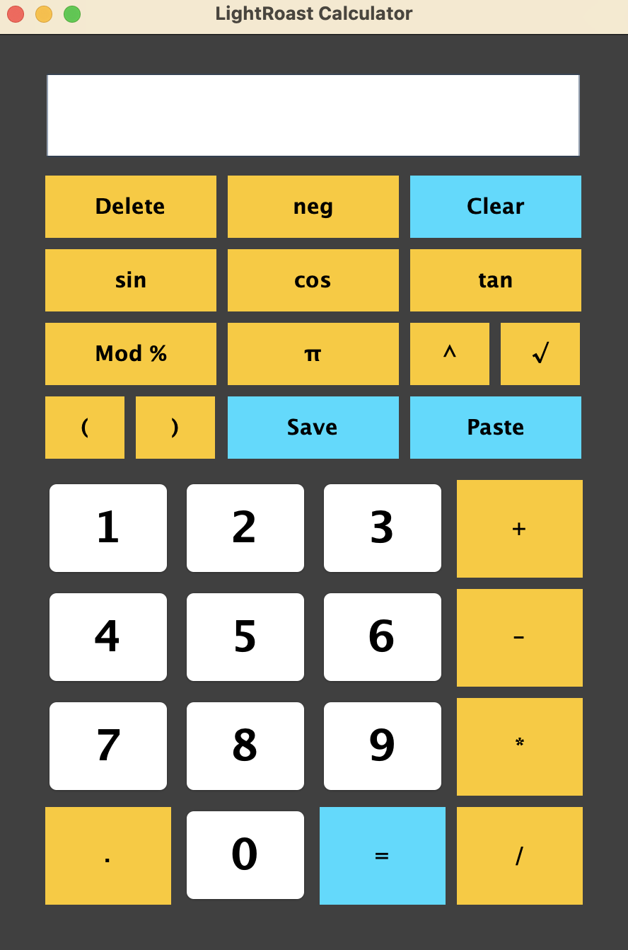
How it looks, for right now:
Major differences to the buttons. Several new buttons such as (), ^, %, π, √, save, and paste.

Slide 4
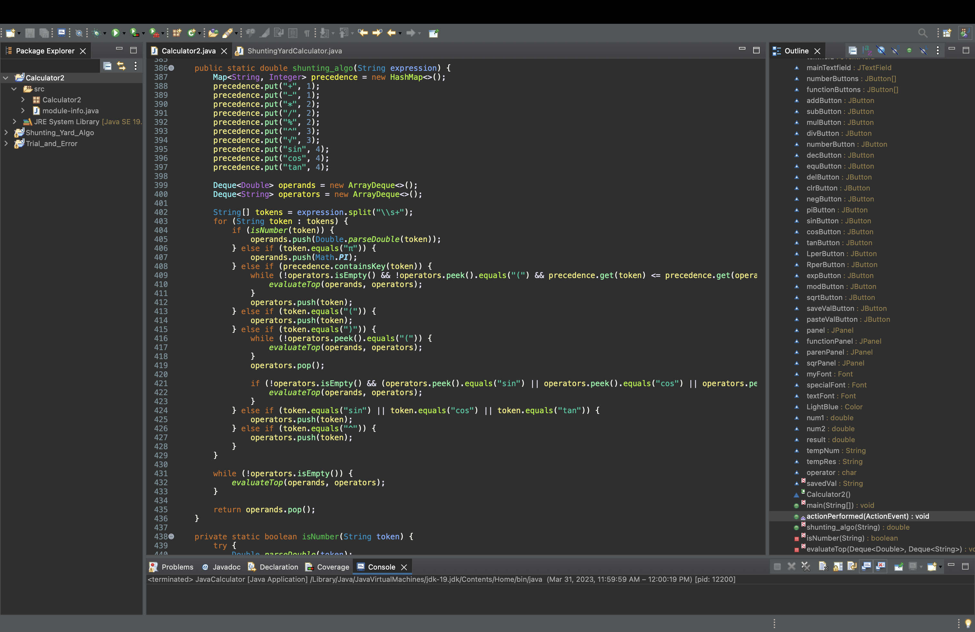
Main Code:
Very small and hard to read, sorry! (Code is in the repo if you want to look at it closer)
Implemented the Shunting Yard Algorithm to sort and evaluate the final expression as a string. Streamlining code and making functions work better for what I need.

Slide 5


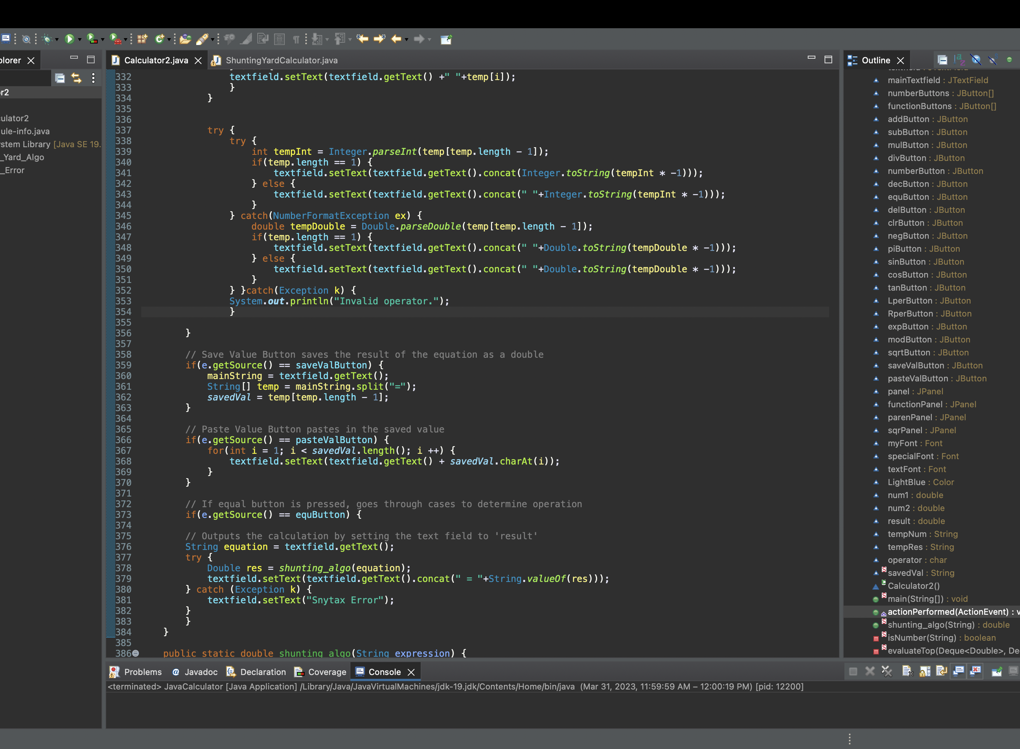
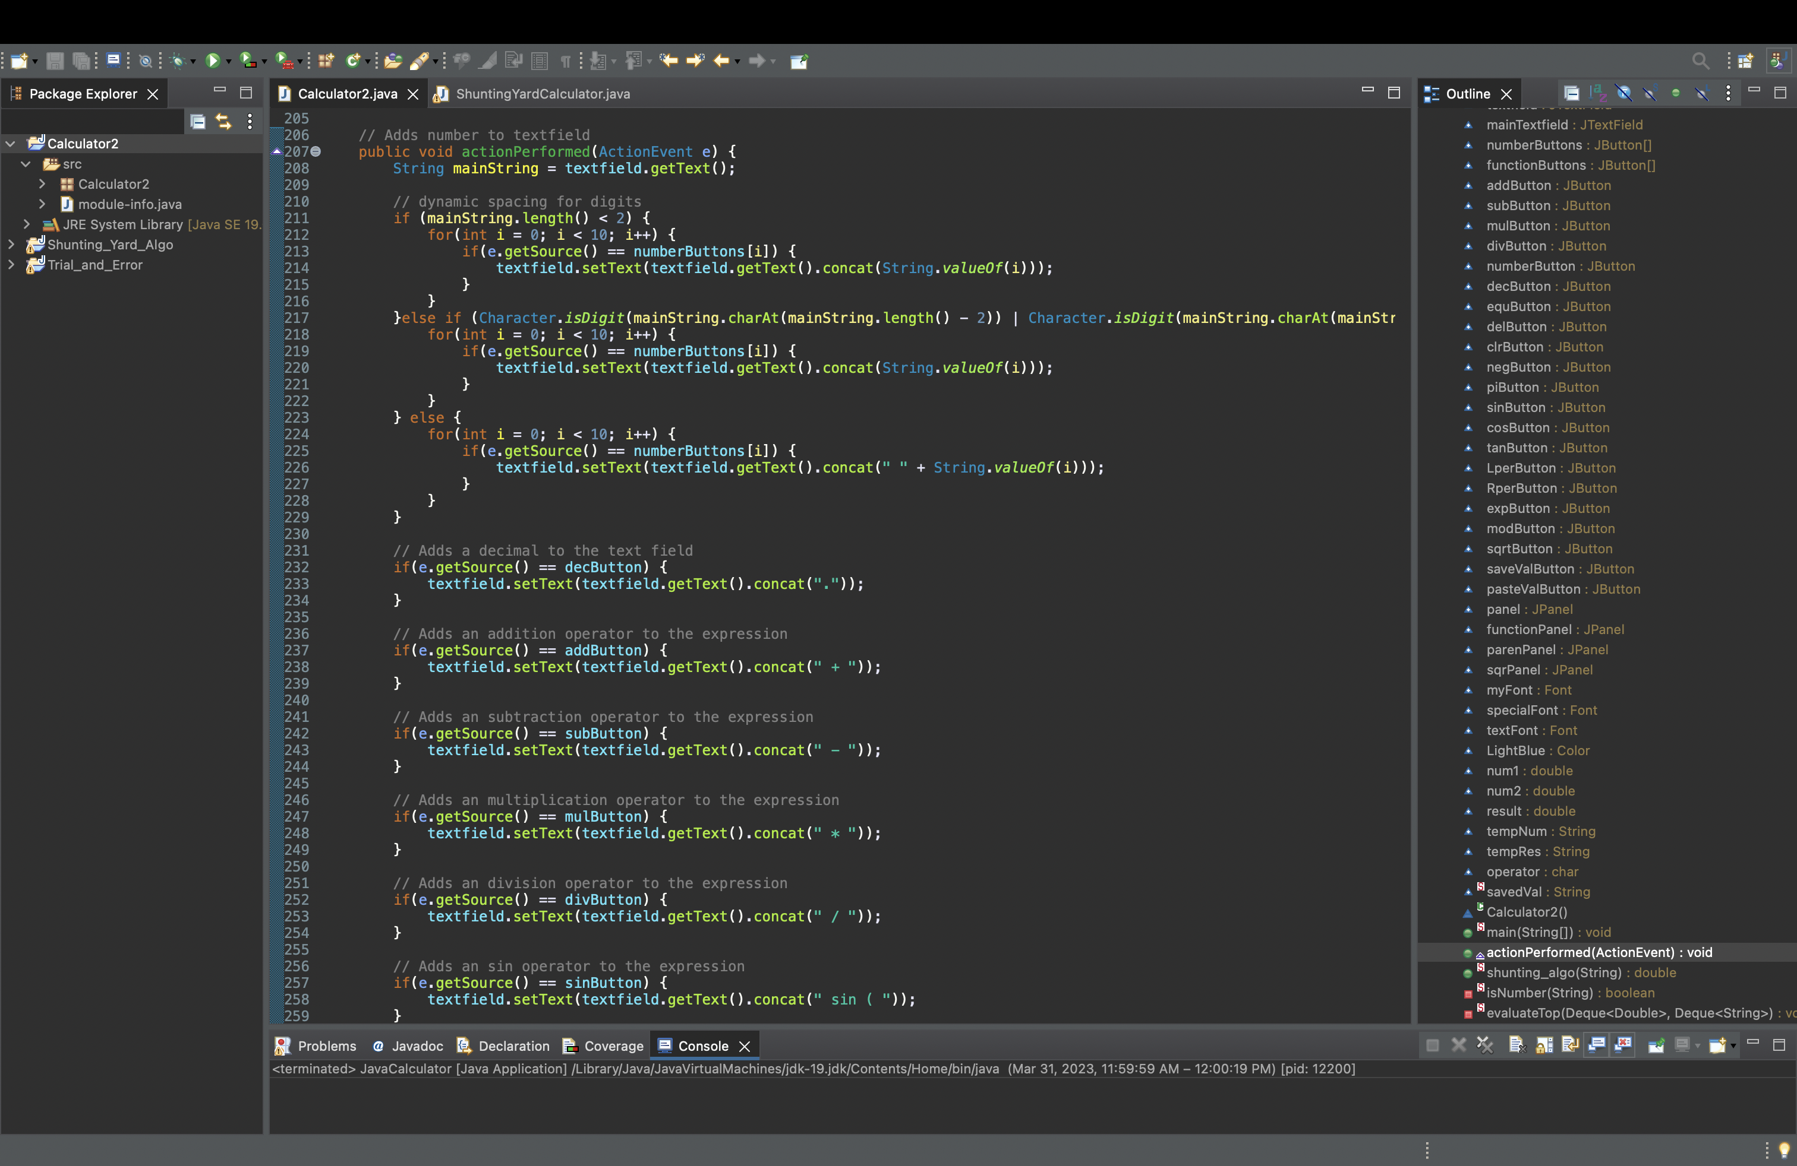
Additional Images of Code
Yes, very hard to read.
(all my code is in repo)

Slide 6
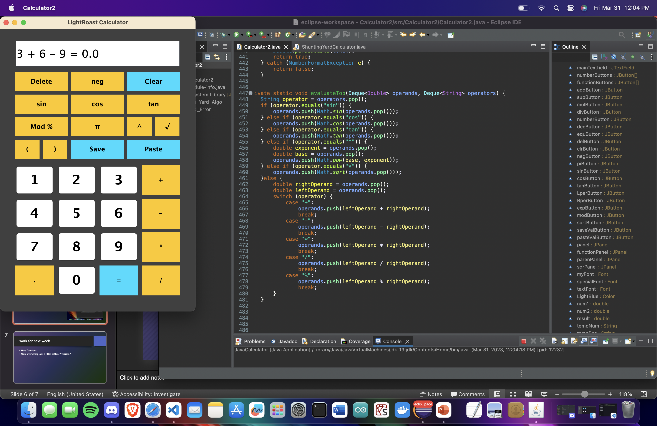

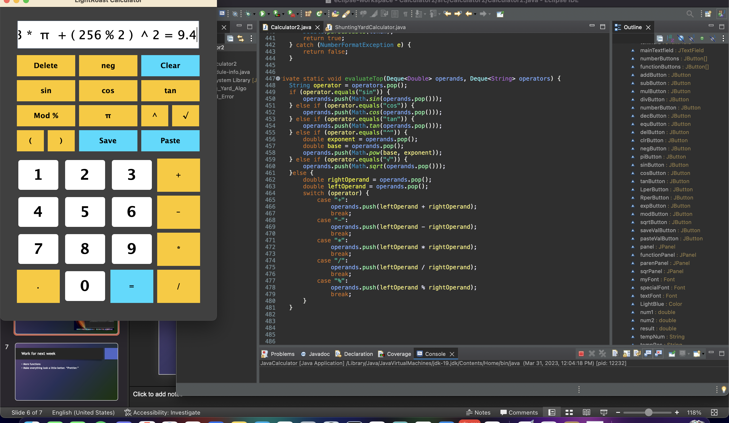
Pictures of Code Running.
Fairly good functionality, trying to work out all bugs.

Slide 7
Work for next week
Test, work out bugs, make into final app.

